Slide 1

What’s out there ?
Notes:
We will now explore the hardware side of what products and technologies that enable high performance computing (HPC) and parallel programming

Slide 2
Processors and Accelerators
Processors
Refers to the Central Processor Unit of a Computer
Referred to as Embedded Processor(core) in various application specific devices
Packs the electronic logic circuitry needed to execute instructions
Main computing/controlling engine in a system
Accelerators
Specific or Generic hardware to enhance software performance on a given system
Secondary performance booster, working in conjunction with Processor
Complete Compute Units as accelerators are also called as “Co-Processors”
Notes:
We know it is the processor or a CPU is considered the heart of a computer and the performance of a computer basically depends on the performance of the CPU.
An accelerator is a specific or generic hardware to further enhance the performance working in conjunction with CPU. Few examples for accelerators include Graphic Processor Unit (GPU), Cryptographic accelerator, 3D accelerators

Slide 3
Multi and Many Core Systems for HPC
Multicore Processors
Powerful computing units, with multiple processors or cores in one (Dual, Quad, 8, 16…)
Operate out of single shared memory address space
Support for Multi-threaded OpenMP and Multi-Process MPI programming standards
Examples. Intel Xeon, AMD Opteron
Many Core Processors
Relatively smaller and less powerful numerous computing units in one system (60 in Xeon-Phi, ranges from 168-960 In tesla)
Some are specific units like GPU, with high degree of vector compute
May(may not) physically connect to one memory unit, but address a distributed address space
Support Multi-Process MPI programming standard
Examples. Intel Xeon-Phi, Nvidia Tesla
Notes:
We know that CPU and accelerators are designed to provide best possible performance to the extent technology allows. Beyond this, it is the trends such as multi core and many core CPUs that help get even higher performance. Each core is capable of executing instructions in parallel with other cores and thus in multicore and many core CPUs there are at least as many or more parallel threads of execution there by enhance the performance of such systems

Slide 4
Intel Processor History
486 DX (32bit) Released in 1989
Running at 66MHz, Pipelined, 32bit word size, 8KB Cache
Pentium with x86 trademark released in 1993
2 instructions per clock cycle
Was able to handle media type like speech and image
Offered multiple processing speed up to 300MHz
Pentium Pro was released in 1995
Able to handle more instructions per clock cycle
Pentium II released in 1998
Was able to handle video audio, graphics with MMX instructions
Processing speeds up to 450MHz
Pentium III release in 1999
Additional 70 instructions to better handle audio, video, graphic
Better Internet experience
Pentium IV release in 2001
Hyper pipelined technology, Rapid Execution Unit
Upto 1.5GHz
Notes:
Intel has been spearheading the evolution of processor technology. Here is a quick overview of the Intel’s processor history

Slide 5
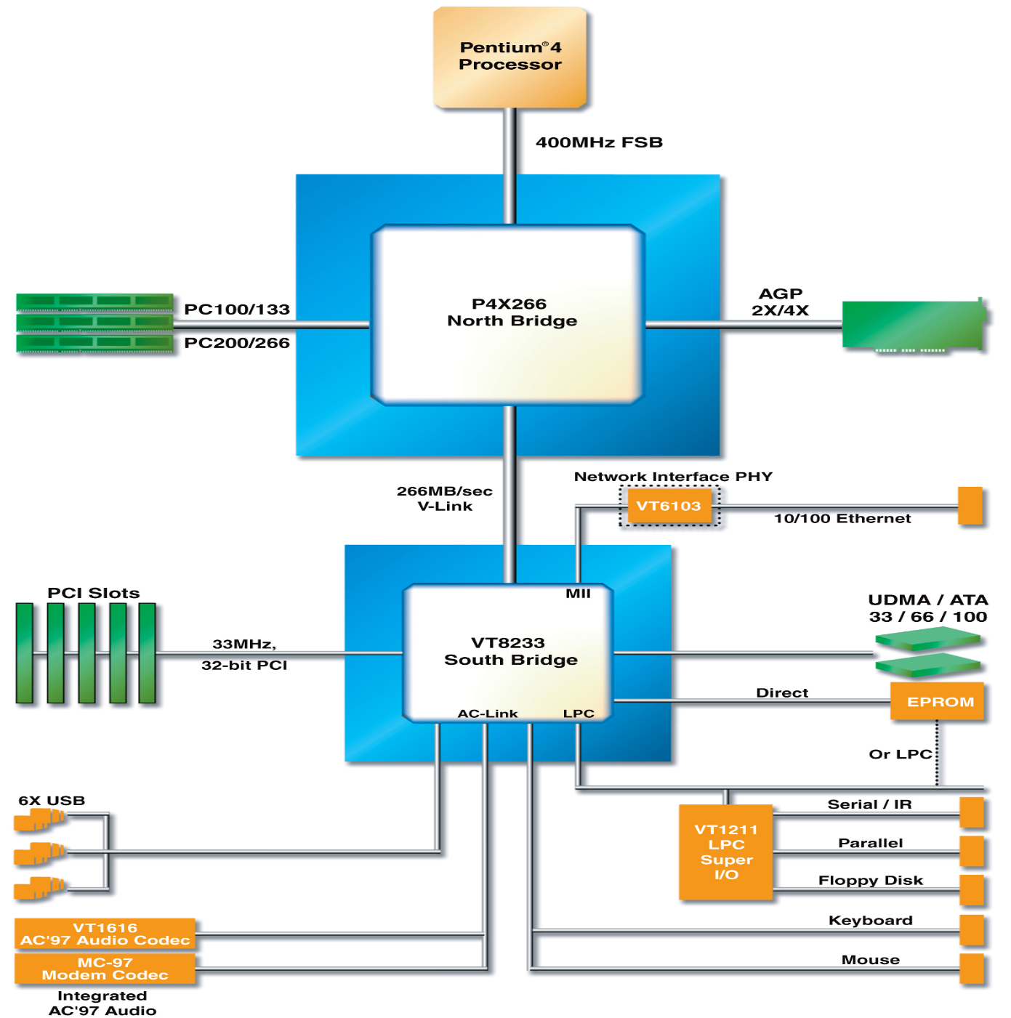
Pentium IV Block Diagram
Notes:
Intel Pentium processor is one of the series of processors released in November 2000. Here is an block diagram

Slide 6
Intel Processor History
http://download.intel.com/pressroom/kits/IntelProcessorHistory.pdf

Slide 7
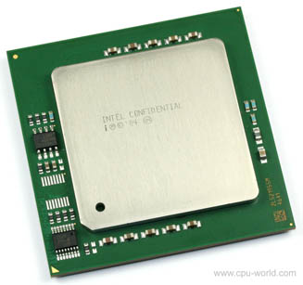
Xeon Architecture
Xeon is a brand name x86 (and x86-64) Microprocessor manufactured by Intel for the server market.
Current day Xeon enables creation of Multi-core, Multi-Socket clusters, with ECC memory support for high reliability
First dual-core Xeon was introduced in 2005. Paxwell DP (2 Cores, 4MB L2 Cache, 1.4MHz) and 7000-Series Paxville MP (2 Cores, 2MB L2 Cache, 2.8GHz)
Note: DP Implies Dual Processor, can use single or double socket on a mother board. MP Implies Multi Processor, providing room to build mother boards with 4 or more sockets.
Notes:
Intel Xeon is another processor from Intel targeted to workstations and servers. It enables creation of multi-core multi-socket clusters for High Performance Computing (HPC) needs

Slide 8
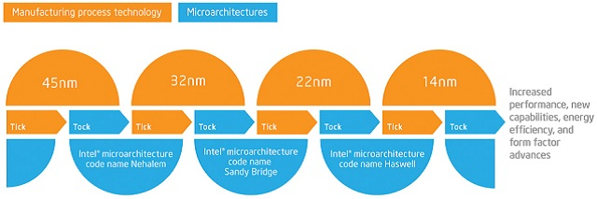
Technologies used in Xeon Architecture
Intel Advances innovation on a Tick-Tock Model. Tick refers to Process Technology, while Tock refers to architecture developments
Nehalem Core on 45nm were introduced in 2008.
Intel Started its Core-based series with Sandy-Bridge on 32nm, released in 2011
This was followed by Ivy-Bridge on 22nm in 2013
Followed by Low-power Haswell on 22nm, in 2013
Source: http://www.intel.com/content/www/us/en/silicon-innovations/intel-tick-tock-model-general.html
Notes:
Process technology advancements shrinks the processor, scales the semiconductor devices with advanced fabrication process. Micro architecture advancements enhance the speed through changes to the processor’s micro architecture, e.g multiple cores, cache size, pipeline, etc.

Slide 9
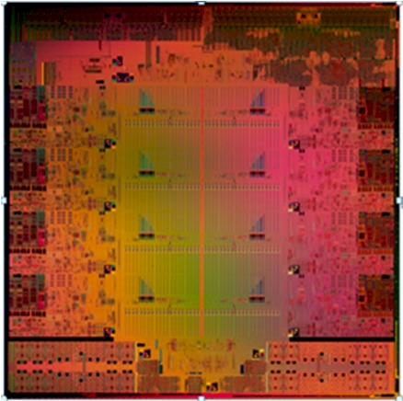
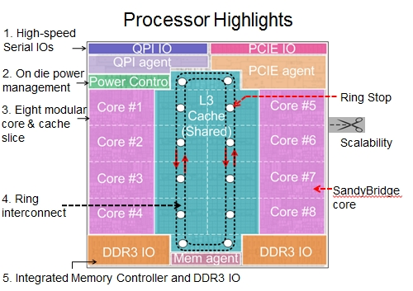
Sandy-Bridge
Notes:
Sandy bridge is the code name of Microarchitecture developed by Intel. You can see here sandy bridge die and microarchitecture. Xeon processors are based on Sandy bridge arhchitecture

Slide 10
Sandy Bridge’s Salient Features
Sandy Bridge architecture is targeted at 32nm Technology
Intel Hyper- Threading technology (2 cores -> 4 Threads, 4 core -> 8 Threads)
Integrated memory controller(2ch DDR3)
High Bandwidth Last Level Cache(LLC) shared among processors and graphics
Ring-based interconnect between cores, Graphics, LLC and System Agent Domain.
Notes:
As-is

Slide 11
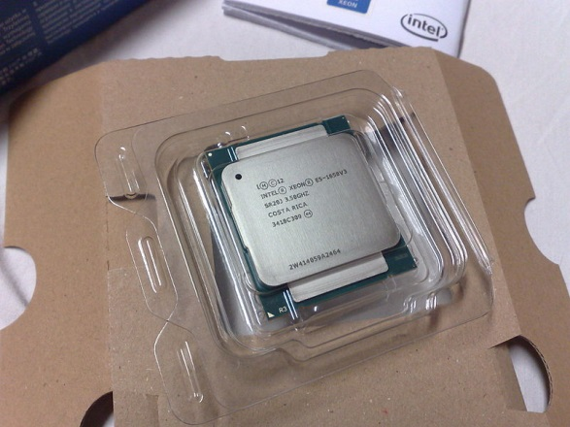
Intel Xeon
Targeted to Server, Workstation and embedded line of processors
Features:
Multi-socket capabilities
Higher core count
Error-correcting Code (ECC) Memory
Tianhe-IA one of the supercomputers that uses Xeon is the first to be placed in top500 super computers.
Intel Xeon E5-1650 v3 CPU
Notes:
AS-is

Slide 12
What is a Coprocessor?
Supplement for primary processor (CPU)
Operations performed by the coprocessor may be floating point arithmetic, graphics, signal processing, string processing, encryption or I/O Interfacing with peripheral devices.
Accelerates system performance.

Slide 13
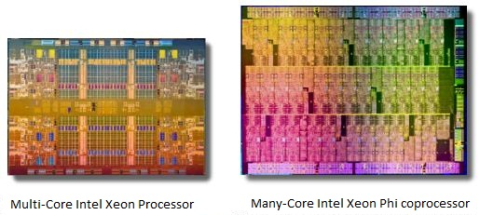
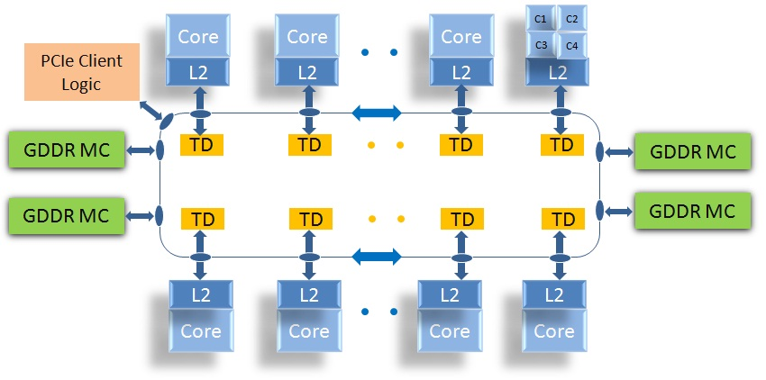
Xeon Phi™
Xeon Phi is a MIC (Many Integrated Core) architecture
Designed to be a coprocessor to supplement the Xeon system
Each core includes a large vector register, vector unit and dedicated cache
50+ Cores with 6+GB of DDR5 Memory
Each Core Supports 4 way Hyper Threading
Each Core has its own PMU (Performance Monitoring Unit)
DDR Bandwidth achieved performance of over 200GB/sec
Notes:
Xeon-phi is a coprocessor with many integrated cores that works in conjunction with Xeon system to deliver high performance.
You can see here the Xeon-Phi block diagram with many cores, each with its own cache, interconnected through a bi-directional ring bus with GDDR (Graphics Double Data Rate) memory controllers and Tag Directories (TD). There is one tag directory per processor core and these directories are used to see if the desired data resides anywhere on the chip in the case of a local L2 cache miss.
Host Xeon system connects with Xeon-Phi via PCIe. Although the physical system link is PCIe, it runs TCPIP so that the entire chip looks like a familiar computing cluster

Slide 14
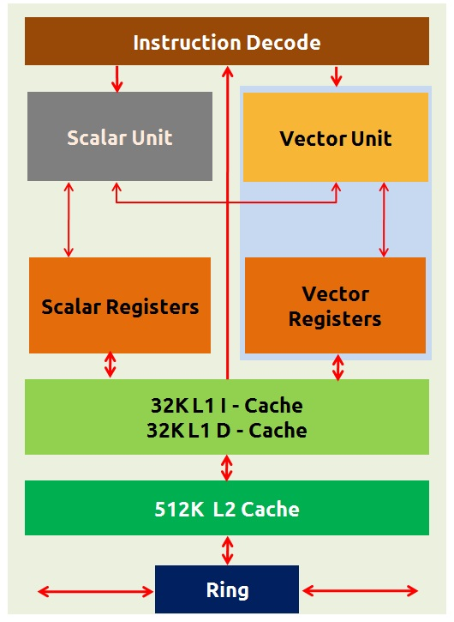
Xeon Phi Core
32KB Data + 32KB Code L1
512 bit SIMD, Vector register
512KB of dedicated memory for each core, L2
Notes:
We can see here the inside of Intel Xeon-phi core with instruction pipeline, scalar and vector units, cache connected to the Ring bus. Vector unit is capable of executing an operation (say add or multiply) on multiple operands simultaneously. Recall the brief discussion on Single Instruction Multiple Data (SIMD), Cache enables quicker access to the data.

Slide 15
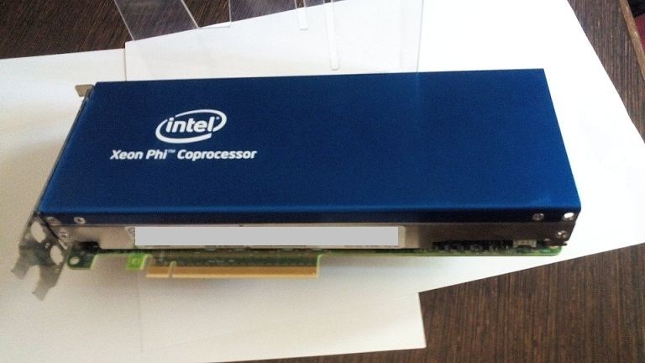
Xeon Phi Card
Xeon Phi offering comes as an add-on PCIe system
Notes:
Here is a physical view of Xeon-phi card that plugs into a Xeon system via PCIe interface.

Slide 16
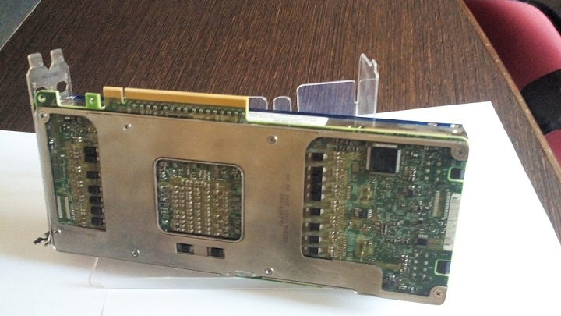
Xeon Phi Card
Notes:
Here is another view of Xeon-phi card

Slide 17
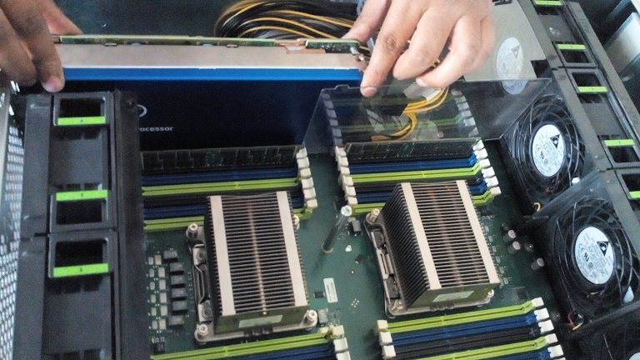
Xeon Phi Card
Notes:
One more view of a xeon-phi card

Slide 18
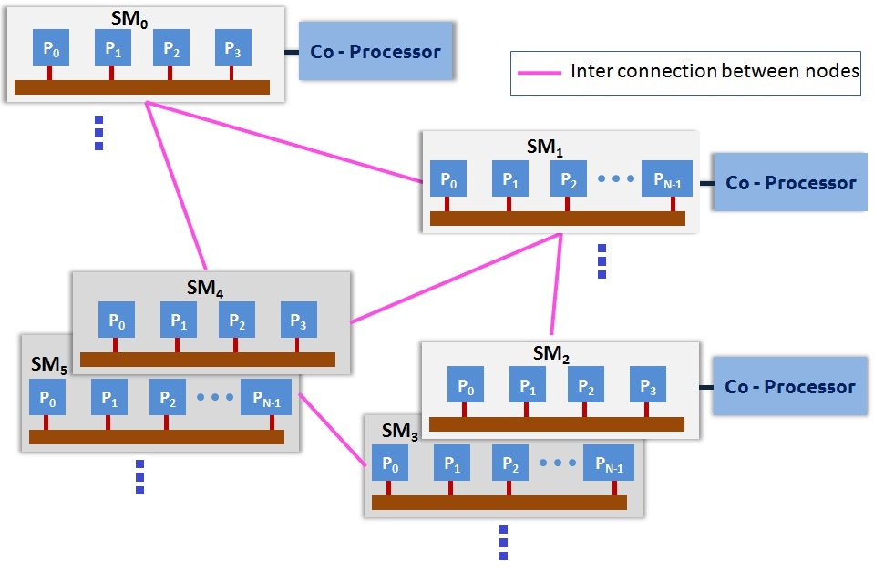
Schematic diagram of a Cluster
Notes:
A complex problem can be decomposed into multiple smaller tasks that are executed in parallel on multiple individual nodes(computers) each with multiple processors to achieve high performance. There are standards such as OpenMP and MPI and implementations of these specifications in the form C, C++ or Fortran libraries or APIs that would enable developing parallel programs in one such cluster

Slide 19
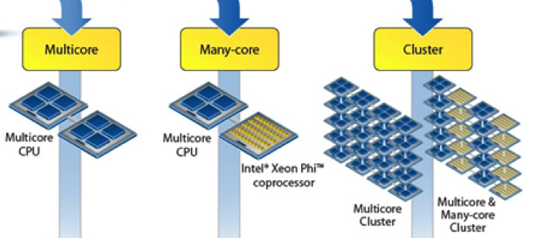
Multi-Core and Many-Core(Cont…)

Slide 20
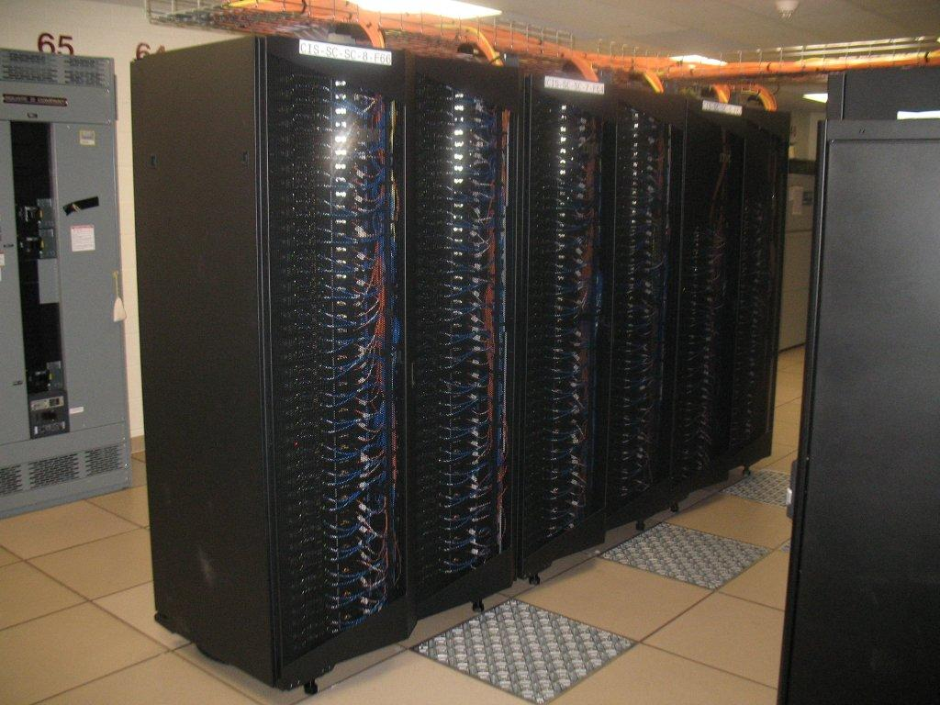
Typical HPC Cluster
Eos – an IBM iDataplex Cluster (http://sc.tamu.edu/systems/#eos)
OS: Linux (RedHat Enterprise Linux and CentOS)
No. of Nodes:372(324 8-way Nehalem- and 48 12-way Westmere-based)
Number of Processing Cores: 3168(all@2.8GHz)
Interconnect Type: 4x QDR Infiniband (Voltaire Grid Director GD4700 switch)
Peak Performance: 35.5 Tflops
Total Disk: 500 TB by a DDN S2A9900 RAID Array

Slide 21
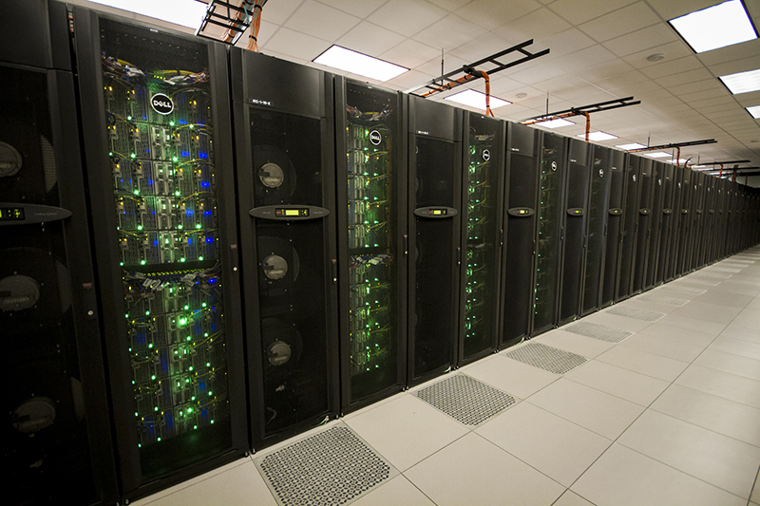
Typical HPC Cluster
STAMPEDE (Source: https://portal.tacc.utexas.edu/user-guides/stampede#overview)
Component | Technology | Performance/Size
Nodes | 2 8-core Xeon E5 processors, 1 61-core Xeon Phi coprocessor | 6400 Nodes
Memory | Distributed, 32GB/node | 205TB(Aggregate)
Shared Disk | Lustre 2.1.3, parallel File System | 14 PB
Local Disk | SATA (250GB) | 1.6PB (Aggregate)
Interconnect | InfiniBand Mellanox Switches/HCAs | FDR 56 Gb/s

Slide 22
<Blank>

Slide 23
<Blank>

Slide 24
<Blank>

